Slide 1
Romania – Republic of Serbia IPA Cross-border Cooperation Programme
Programming Languages
Lecturer: lect. dr. eng. Razvan BOGDAN
Notes:
Slide 1: Hello everyone and welcome to programming languages course.

Slide 2
Programming Languages
Lecture 3
Conditional execution
Notes:
Slide 2: In this lecture we are going to talk about Conditional execution.

Slide 3
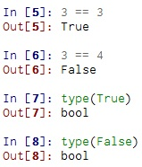
Boolean expressions (1)
Boolean expressions ask a question and produce a Yes/True or No/False result which we use to control program flow
Notes:
Slide 3: Boolean expressions (1): A boolean expression is an expression that is either true or false. The following examples use the operator ==, which compares two operands and produces True if they are equal and False otherwise. True and False are special values that belong to the type bool as it can be seen that we obtain when we apply type to either True or False.

Slide 4
Boolean expressions (2)
Boolean expressions using comparison operators evaluate to - True / False - Yes / No
Comparison operators look at variables but do not change the variables
Python | Meaning
< | Less than
<= | Less than or Equal
== | Equal to
>= | Greater than or Equal
> | Greater than
!= | Not equal
= is different than ==
Notes:
Slide 4: Boolean expressions (2): == is only one of the comparison operators. The rest are presented in the table, being less than, less than or equal, equal to, greater then or equal, greater than and not equal. You should know that Python symbols are different from the mathematical symbols. A common error is to use a single equal sign (=) instead of a double equal sign (==). Remember that = is an assignment operator and == is a comparison operator.

Slide 5
Logical Operators
Logical AND ( and )
if x > 0 and y > 0 : print 'both numbers are positive'
Logical OR ( or )
if x > 0 or y > 0 : print 'either x or y is evaluated as positive'
Logical NOT ( not )
if not( x > y ) : print 'x is less than or equal to y'
A | B | A and B | A or B | not A
true | true | true | true | false
true | false | false | true | false
false | true | false | true | true
false | false | false | false | true
Notes:
Slide 5: Logical Operators: Python provides a set of logical operators to combine multiple boolean expressions together for more complex boolean logic testing and operations.
- and logical operator checks whether both boolean expressions evaluate as true
or checks whether either expression is evaluated as true
not negates a boolean expression, i.e. if the bool value returned is false then not evaluates to true.
Considering that A and B are boolean expressions, we can build the truth table presented of these logical operators as you can see on the slide.

Slide 6
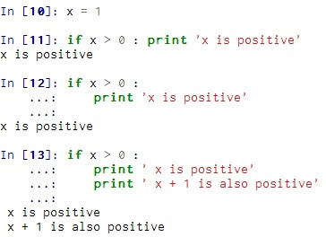
Conditional execution (1)
Conditional statements let Python know it is about to enter a decision-making structure
The if statement is the simplest
Conditional statements end with the : colon character, after which the code you may want to execute is placed
The line(s) after the if are indented
First image source: Ch. Severance, Python for Informatics: Exploring Information
Notes:
Slide 6: Conditional execution: In order to write useful programs, we usually need the capacity to check different conditions and change the behavior of the program according to those situations. Conditional statements give us this ability. The simplest form is the if statement. The boolean expression after the if statement is called the condition. We end the if statement with a colon character (:) and the line(s) after the if statement are indented. If the logical condition is true, then the indented statement will be executed. If the logical condition is false, the indented statement will be skipped.
In the first example (which is starting on line 10) the print function is placed on the same line as the if statement, immediately following the colon character (:). “This is an acceptable format if you only have one line of code you want to execute after your conditional statement. If there is a whole section of code that you want to execute (like in the third example starting on line 13, often referred to as a code block), then the valid syntax is to place them in the following lines under the if and indent it 4 space characters in, forming a visual code block.” (https://share.coursera.org/wiki/index.php/Pythonlearn:resources-week03)

Slide 7
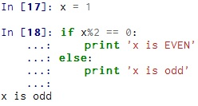
Conditional execution (2)
Alternative execution
Second image source: Ch. Severance, Python for Informatics: Exploring Information
Notes:
Slide 7: Conditional execution (2): A second form of the if statement is alternative execution, in which there are two possibilities and the condition determines which one gets executed. In the presented example, if the remainder when x is divided by 2 is 0, then x is even, and the program will display a message to that effect. If the condition is false, the second set of statements is executed.
If the remainder when x is divided by 2 is 0, then x is even, and the program displays a message to show this effect. If the condition is false, the second set of statements is executed. Since the condition must be true or false, exactly one of the alternatives will be executed. The alternatives are called branches, because they are branches in the flow of execution. (Charles Severance, Python for Informatics: Exploring Information)

Slide 8
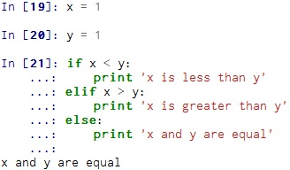
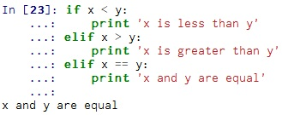
Conditional execution (3)
Chained conditionals
elif is an abbreviation of “else if”
if there is an else clause, it has to be at the end, but there doesn’t have to be one
Second image source: Ch. Severance, Python for Informatics: Exploring Information
Notes:
Slide 8: Conditional execution (3): Sometimes there are more than two conditional possibilities and therefore there will be more than two branches. One way to express a computation like that is a chained conditional as we are having in the example. In this case exactly one branch will be executed. Please pay attention that elif is an abbreviation of “else if”. We don’t have any restriction on the number of elif statements, but if there is an else clause, it has to be at the end; anyway it is not mandatory to have an else clause. Each condition is checked in order. If the first is false, the next is checked, and so on. If one of them is true, the corresponding branch will be executed, and the statement will end. If more than one condition is true, only the first true branch will execute.

Slide 9
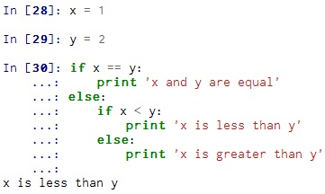
Conditional execution (4)
Nested conditionals
One conditional can also be nested within another
Second image source: Ch. Severance, Python for Informatics: Exploring Information
Notes:
Slide 9: Conditional execution (4): There are some cases when one conditional can also be nested within another. The previous example can be rewritten for this purpose, but although the indentation of the statements makes the structure apparent, nested conditionals become difficult to read very quickly. In general, it is a good idea to avoid them whenever is possible.

Slide 10
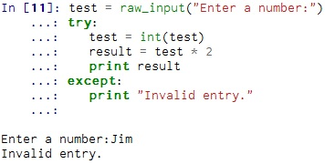
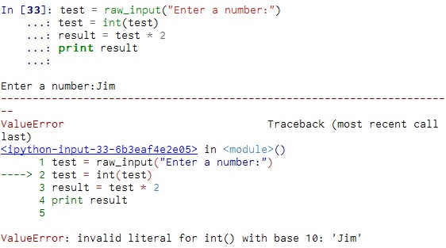
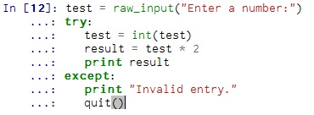
Catching exceptions using try and except
You surround a dangerous section of code with try and except.
If the code in the try works - the except is skipped
If the code in the try fails - it jumps to the except section
Notes:
Slide 10: Try/except (1): “There is a conditional execution structure built into Python to handle potentially error prone code called the “try / except” block. The idea of try and except is that if you know that a particular block of code may have a problem executing and you want to maintain some semblance of program control instead of Python simply quitting with errors when it encounters this potentially volatile code, you can provide Python an alternative block of code to be executed if an error occurs. These extra statements (the except block) are ignored if there is no error. This is especially useful for code that involves potentially erroneous user input but can apply to any code debugging situation you're dealing with.
Beginning with try Python tests the first operation. If the operation fails then it proceeds to follow the instructions in except. If the try is successful then except is skipped.” (from https://share.coursera.org/wiki/index.php/Pythonlearn:resources-week03)
Let’s take the following example: we would like to read an integer value from the keyboard and multiply that value by 2. If we fail to introduce an integer value (for example we are introducing a sequence of characters) then the script immediately stops in its tracks with a traceback. We can rewrite our code to test whether the input is a number. If the input is a number we will compute the multiplication; if not then a message will be displayed.
“Because after an except block is finished, executing the program will continue to run any code in the main body beyond the try/except block. In the case of the above example, we can either set test = 1 or some other default value before we let it continue execution or we can prompt the user and quit() within the except block itself” as we see in the example starting at line 12 (from https://share.coursera.org/wiki/index.php/Pythonlearn:resources-week03)
Handling an exception with a try statement is called catching an exception. In this example, the except clause prints an error message. In general, catching an exception gives you a chance to fix the problem, or try again, or at least end the program gracefully. (Charles Severance, Python for Informatics: Exploring Information)

Slide 11
Homework
Rewrite your pay computation to give the employee 1.5 times the hourly rate for hours worked above 40 hours.
Rewrite your pay program using try and except so that your program handles non-numeric input gracefully by printing a message and exiting the program
Write a program which prompts the user for a Celsius temperature, convert the temperature to Fahrenheit and print out the converted temperature. Each value that is read from the user should be real. Therefore use a variable fahr = float(inp)
Notes:
Slide 11: Homework: As homework, please try and solve the following problems: first of all, try to implement in Canopy all the provided examples. After that rewrite your pay computation to give the employee 1.75 times the hourly rate for hours worked above 40 hours; after that, rewrite your pay program using try and except so that your program handles non-numeric input gracefully by printing a message and exiting the program; and finally convert a Celsius temperature into Fahrenheit, but each value that is read from the user should be real; non-numeric values will be dealt with try and except.

